Slide 1
자료구조 및 알고리즘 - Introduction (Chap 1 & 2)
Taehyoun Kim
Dept. of Mechanical & Information Engineering,
University of Seoul

Slide 2
Introduction to Algorithm Analysis & Math Preliminaries

Slide 3
다시 정리하기: 알고리즘
알고리즘이란 ?
주어진 문제 해결을 위해 문제를 분할하고 이에 대한 해결 방안을 잘 정의된 일련의 절차 (명령어)로 재정의한 것
문제 분할
해결 대상 문제
do action 1
do action 2
Algorithm
…
…
do action n
실제 구현
Computer Program

Slide 4
다시 정리하기: 알고리즘 분석
풀어야 할 문제 (Problem)와 문제 해결의 절차
주어진 문제의 해결 방안과 절차는 단 한 가지 뿐일까 ?
알고리즘 분석이 필요한 이유 ?
해결 대상 문제
유용한 형태로 변환
Input
data
Output
data
문제 해결의 절차: Algorithm
Notes:
하드웨어의 눈부신 발전이 모든 것을 해결해 줄까 ?
실제 컴퓨터 프로그램에서는 제한된 자원 (시간, 저장공간)을 활용할 수 밖에 없으므로 각 알고리즘의 효율성 분석을 통해 주어진 조건에서 최적의 알고리즘을 선택해야 함

Slide 5
다시 정리: 자료구조
자료 구조란 ?
컴퓨터에서의 프로그램 성능은 실제 데이터에 대해 실행되는 연산 (산술, 논리, 비교 등) 보다 데이터를 읽고 쓰는 데 드는 비용 (시간)에 좌우되는 경향이 있음
단순하게는 (주로) 동일 타입의 데이터 아이템들을 집합으로 관리하는 구조 혹은 체계를 뜻함
실제로는 데이터의 관리 구조 및 이 구조에 근거한 연산 (초기화, 탐색, 삽입, 삭제 등)까지 포함하는 개념임

Slide 6
다시 정리: 알고리즘과 자료구조
아래와 같이 실제 상황에서는 자료구조의 형태는 특정 알고리즘의 적용을 어렵게 한다거나 변형을 요구하게 됨
해결 대상 문제
유용한 형태로 변환
Input
data
Output
data
Algorithm
Data Structure

Slide 7
Math Preliminaries
Exponents
X^{A}X^{B} = X^{A+B}
X^{A}/X^{B} = X^{A-B}
(X^{A})^{B} = X^{AB}
X^{N}+X^{N} = 2X^{N} ≠ X^{2N}
2^{N}+2^{N} = 2^{N+1}

Slide 8
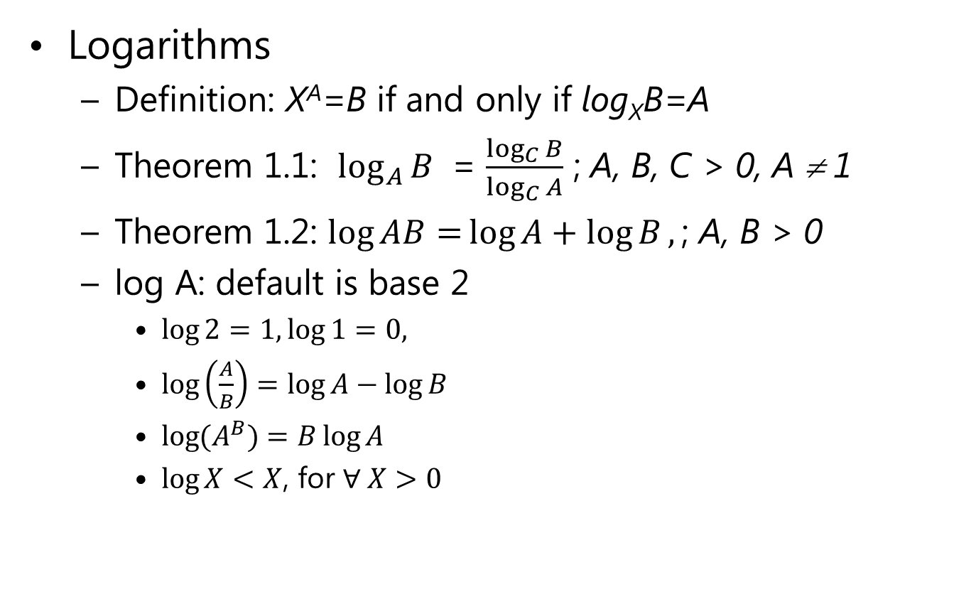
Math Preliminaries
Logarithms
Definition: X^{A}=B if and only if log_{X}B=A
Theorem 1.1: $\log_{A}{B }$ = $\frac{\log_{C}{B}}{\log_{C}{A}}$ ; A, B, C > 0, A ≠ 1
Theorem 1.2: $\log{AB=}\log{A}+\log{B},\text{; }\text{A}\text{, }\text{B}\text{ > 0}$
log A: default is base 2
$\log{2=1, \log{1}=0, }$
$\log\left(\frac{A}{B}\right)=\log{A}−\log{B}$
$\log{{(A}^{B})=B}\log{A}$
$\log{X}<X$, for $∀ X>0$

Slide 9
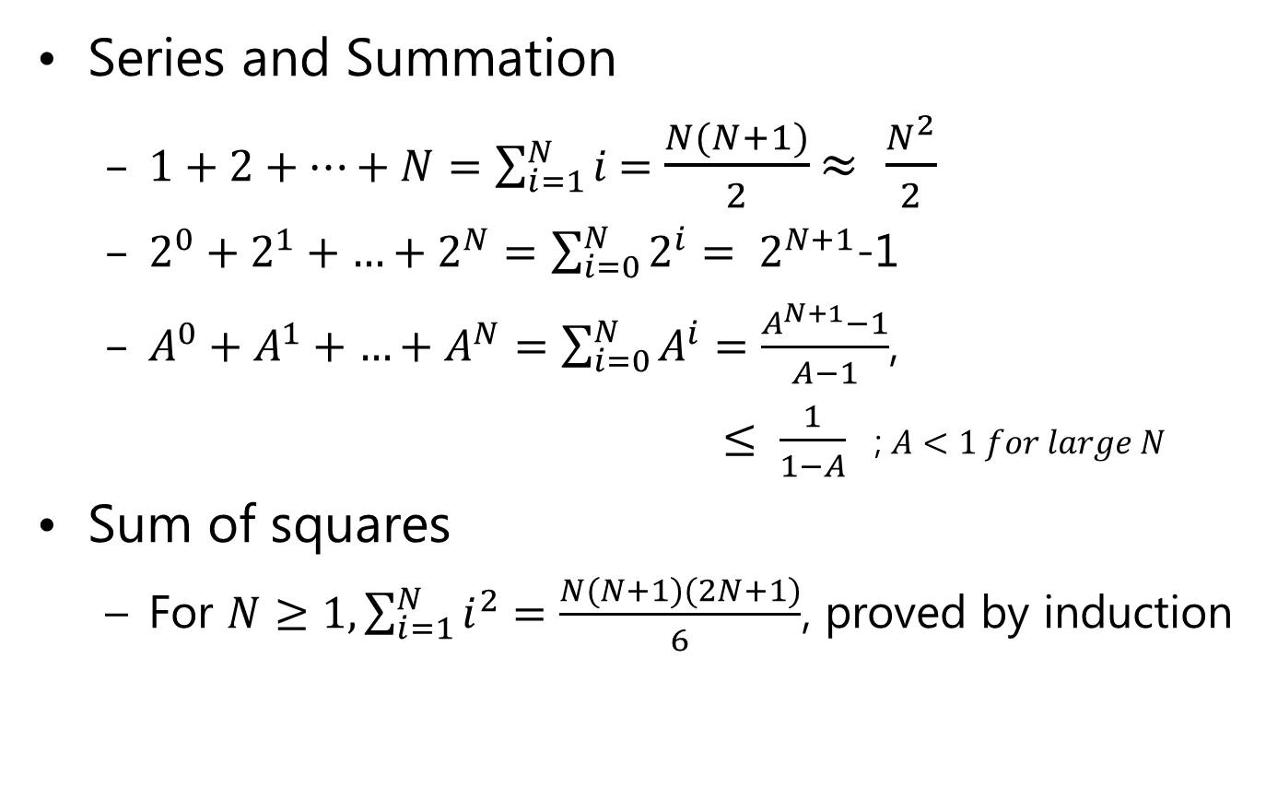
Math Preliminaries
Series and Summation
$1+2+…+N=\sum_{i=1}^{N}{i}$=$\frac{N(N+1)}{2}$ $≈ \frac{N^{2}}{2}$
$2^{0}+2^{1}+{…+2}^{N}=\sum_{i=0}^{N}{2^{i}}= 2^{N+1}$-1
$A^{0}+A^{1}+{…+A}^{N}=\sum_{i=0}^{N}{A^{i}}=\frac{A^{N+1}−1}{A−1}$,
$≤ \frac{1}{1−A}$ ; $A<1 for large N$
Sum of squares
For $N≥1, \sum_{i=1}^{N}{i^{2}=\frac{N(N+1)(2N+1)}{6}}$, proved by induction

Slide 10
Running Time Analysis
Two ways to measure relative efficiency of an algorithm
Mathematical analysis
Empirical analysis
Mathematical analysis of the running time
Running time is measured by the number of “basic steps” (e.g., the number of C statements) that the algorithm makes.
Running time is described as a function of input size n, T(n)
We are usually interested in the worst-case running time

Slide 11
The Big-Oh (O) Notation
Example: T(n) = 13n³ + 42n² + 2nlogn + 4n
As n grows larger, n³ is MUCH larger than n², nlogn, and n,
so it dominates T(n)
The constant factor 13 can be ignored since it is affected by the compiler used or machine speed, etc.
The running time grows “roughly on the order of n³”
Notationally, T(n)=O(n³)
Notes:
SKT의 가입자 수는 천만명이 넘음 – 전체 가입자를 대상으로 특정한 계산을 한다고 할 때
Pentium Pro 칩에는 약 500만개 이상의 트랜지스터가 포함되어 있음.

Slide 12
Formal Definition of the Big-Oh
Definition 1
T(n) = O(f(n)) if there are constants c and n₀ such that T(n) ≤ c f(n) when n ≥ n₀.
It is inappropriate to compare two functions absolutely.
Can compare the relative rates of growth of two functions e.g.) 1000n and n² → 1000n = O(n²) (c=1, n₀=1000)
Useful for putting an upper bound of a function e.g.) if T(n) = O(n³) then T(n) = O(n⁴), T(n) = O(n⁵), etc.
If T₁(n) = O(f(n)) and T₂(n) = O(g(n)), then T₁(n) + T₂(n) = max(O(f(n)), O(g(n))) T₁(n) * T₂(n) = O(f(n)*g(n))

Slide 13
Definitions of Ω, Θ, and o
Definition 2
T(n) = Ω(g(n)) if there are constants c and n₀ such that T(n) ≥ c g(n) when n ≥ n₀
describes a lower bound
Definition 3
T(n) = Θ(h(n)) if and only if T(n) = O(h(n)) and T(n) = Ω(h(n))
describes a tight bound
Definition 4
T(n) = o(p(n)) if T(n) = O(p(n)) and T(n) ≠ Θ(p(n))

Slide 14
Various Growth Rates
T(n) = O(1) : Constant time
T(n) = O(log log n) : As fast as constant time
T(n) = O(log n) : logarithmic time
T(n) = O((log n)^{k}) : polylogarithmic time
T(n) = O(n) : linear time
T(n) = O(n log n) : famous for sorting
T(n) = O(n²) : quadratic time
T(n) = O(n^{k}) : polynomial time
T(n) = O(2^{n}), T(n) = O(n^{n} ), T(n) = O(n!) : exponential time
practical for small values of n (e.g. n = 10 or n = 20)
Notes:
O(2^n), O(n^n), O(n!) 중 어느 것이 가장 빠르게 증가할까?

Slide 15
Computational Complexity
g(n)
2^{n}
n³/2
5n²
3000
100n
2000
1000
5
10
15
20
n

Slide 16
Computational Complexity
Function | Approximate Values
n | 10 | 100 | 1000
nlogn | 33 | 664 | 9966
n³ | 1,000 | 1,000,000 | 10⁹
10⁶n⁸ | 10¹⁴ | 10²² | 10³⁰
2^{n} | 1024 | 1.27x10³⁰ | 1.05x10³⁰¹
n^{logn} | 2099 | 1.93x10¹³ | 7.89x10²⁹
n! | 3,628,800 | 10¹⁵⁸ | 4x10²⁵⁶⁷

Slide 17
Computational Complexity
Function | Size of Instance Solved in One Day | Size of Instance Solved in a Computer 10 Times Faster
n | 10¹² | 10¹³
nlogn | 0.948x10¹¹ | 0.87x10¹²
n² | 10⁶ | 3.16x10⁶
n³ | 10⁴ | 2.15x10⁴
10⁸n⁴ | 10 | 18
2^{n} | 40 | 43
10^{n} | 12 | 13
n^{logn} | 79 | 95
n! | 14 | 15

Slide 18
Running Time Calculation
1. Summation for Loops
for ( i = 1; i <= N; i++) for ( i = 1; i <= N; i++)
for( j = 1; j <= N; j++)
(a) (b)
If loop body of (a) takes f(i) times, T(n) =
If loop body of (b) takes g(i,j) times, T(n) =
constant sum
linear sum

Slide 19
Running Time Calculation
2. Sequential and If-Then-Else Blocks
for ( i = 0; i < N; i++)
A[ i ] = 0;
for ( i = 0; i < N; i++)
for ( j = 0; j < N; j++)
A[ i ] += A[ j ] + i + j;
if (Condition)
S1
else
S2

Slide 20
Running Time Calculation
3. Recursion
long int
Factorial (int N)
{
if (N <= 1)
return 1;
else
return N * Factorial (N-1)
}
long int
Fibo(int N)
{
if (N <= 1)
return 1;
else
return Fibo(N-1) + Fibo(N-2);
}
T(N) = 1 when N ≤ 1
T(N) = 1 + T(N – 1) when N>1
T(N) = 2 + T(N – 2) = 3 + T(N –3) = … = N –1 + T(1)
T(N) = O(N)
T(N) = 1 when n ≤ 1
T(N) = T(N-1)+ T(N – 2) + 2 when N>1

Slide 21
Running Time Calculation
Maximum subsequence sum problem: Given n integers a₁, a₂, ..a_{n}, find the maximum value of
Example: -2, 11, -4, 13, -5, -2, the answer is ?
Weiss 2.4.3 includes O(n³), O(n²), O(nlogn) and O(n) algorithms for this problem and presents detailed analysis (for each of them – Please Read!!!)
Running Times obtained by empirical analysis
Time |  | O(n³) | O(n²) | O(nlogn) | O(n)
input size | n=10 | 0.00103 | 0.00045 | 0.00066 | 0.00034
 | n=100 | 0.47015 | 0.01112 | 0.00486 | 0.00063
 | n=1,000 | 448.77 | 1.1233 | 0.05843 | 0.00333
 | n=10,000 | NA | 111.13 | 0.68631 | 0.03042
 | n=100,000 | NA | NA | 8.0113 | 0.29832

Slide 22
Running Time Calculation
Here, we examine the O(n logn) algorithm because
(1) it requires the analysis of a non-trivial recursion
(2) it is based on the divide-and-conquer strategy
Divide-and-Conquer
divide the original problem into two subproblems each of which has the half of the original problem size and is solved recursively.
derive the solution using the two solutions of subproblems
Maximum subsequence sum problem
obtain the maximum subsequence sum in both the left half and the right half of the input (recursively)
obtain the maximum subsequence sum that crosses the middle
the maximum of the three sums is the maximum subsequence sum of this problem.

Slide 23
Analysis of the algorithm
Let
. Then,

Slide 24
Proof by Induction
The most important proof technique in all aspects of computer science and data structures.
The proof is composed of two steps.
Base step: prove the theorem is true for the initial values.
Induction step: assume that the theorem holds for all values up to n, then show that the theorem holds for the next value n+1.

Slide 25
Proof by Induction
Fibonacci Numbers:
Prove that
Base step:
Induction step: assume that the theorem holds for
show that We know that

Slide 26
Logarithms in the Running Time
General rules of logarithm
An algorithm is O(log_{k}n) if it takes O(1) time to cut the problem size by 1/k
Example: binary search
An algorithm is O(n) if it takes O(1) time to cut the problem size by a constant (e.g., one). Example: Factorials

Slide 27
Logarithms in the Running Time
Binary Search: Given an integer X and integers A₀, A₁,…A_{N-1}, which are presorted and already in memory, find i such that A_{i}=X, or return –1 if X does not exist.
int
Binary_Search(ElementType A[ ], ElementType X, int N )
{
int Low, Mid, High;
Low = 0; High = N-1;
while( Low <= High )
{
Mid = ( Low + High ) / 2;
if( A [ Mid ] < X )
Low = Mid + 1;
else if ( A[ Mid ] > X )
High = Mid - 1;
else
return Mid;
}
return NotFound;
}

